Slide 1
Event MANAGEMENT SYSTEM
Manage event by us for better arrangements
Submitted by: Umar Khan

Slide 2
ACKNOWLEDGMENT
In the accomplishment of this project successfully, many people have best owned upon us their blessing and heart pledge support, this time we are utilizing to thank all the people who have been concerned with this project.
We would also like to thank my guide HOD Ma’am who always gave us her valuable suggestions and guidance for completion of our project.
She has help us to overcome the problem and difficulties and proved that he is the best and perfect guide for us. The only reason for our project to turn a success is our guide without him we couldn’t think about our project to complete am indented and also beholden to my partner for supporting me at every step.

Slide 3
INTRODUCTION
Event management is a process of organizing a professional and focused event, for a particular target audience. It involves visualizing concepts, planning, budgeting, organizing and executing events such as wedding, musical concerts, corporate seminars, exhibitions, birthday celebrations, theme parties, etc. Event Management is a multi-million dollar industry, growing rapidly, with events hosted regularly. Surprisingly, there is no formalized research conducted to access the growth of this industry. The industry includes fields such as the MICE (Meetings, Incentives and Events), exhibitions, conferences and seminars as well as live music and sporting events. On the profession side, event management is a glamorous and exciting profession that demands a lot of hard work and dynamism. The logistics side of the industry is paid less than the sales/sponsorship side, though some may say that these are two different industries.

Slide 4
features of the project
.Security
• Easy access
• Fast
• Reliable
• Account
• Login

Slide 5
LANGUAGES USED IN PROJECT
Html
Css
Java Script
Php
Mysql

Slide 6
SOFTWARE REQUIREMENTS
Operating System | : Windows 8,Windows 10
Internet connection | : Wifi, Mobile Data.
Browser | : Google chrome latest version, Firefox, etc
Database | : MySQL.
Performance | : The turn-around time of the project will be medium.
Documentation | : MS-Office

Slide 7
SCOPE OF THE PROJECT
The objective of this application is to develop a system that effectively manages all the data related to the various events that take place in an organization. The purpose is to maintain a centralized database of all event related information. The goal is to support various functions and processes necessary to manage the data efficiently.

Slide 8
EXISTING SYSTEM
This existing system is not providing secure registration and profile management of all the users properly. This system is not providing on-line help. This system doesn’t provide tracking of users activities and their progress. This manual system gives us very less security for saving data and some data may be lost due to mismanagement. This system is not providing event management through internet. This system is not providing proper events information. The system is giving manual information through the event management executer.

Slide 9
Operational Feasibility
Operational feasibility is the measure of how well a proposed system solves the problems, and takes advantage of the opportunities identified during scope definition and how it satisfies the requirements identified in the requirements analysis phase of system development. The operational feasibility assessment focuses on the degree to which the proposed development projects fits in with the existing business environment and objectives with regard to development schedule, delivery date, corporate culture and existing business processes. To ensure success, desired operational outcomes must be imparted during design and development. These include such design-dependent parameters as reliability, maintainability, supportability, usability, producibility, disposability, sustainability, affordability and others. These parameters are required to be considered at the early stages of design if desired operational behave ours are to be realized. A system design and development requires appropriate and timely application of engineering and management efforts to meet the previously mentioned parameters. A system may serve its intended purpose most effectively when its technical and operating characteristics are engineered into the design. Therefore, operational feasibility is a critical aspect of systems engineering that needs to be an integral part of the early design phases.

Slide 10
DESIGN
Design is the first step in development phase for any techniques and principles for the purpose of defining a device , a process or system in sufficient detail to permit its physical realization. Once the software requirement have been analyzed and specified the software design involves three technical activities-Design, Coding, Implementation, Testing that are required to build and verify the software. The design activities are of main importance in this phase, because in this activities decisions ultimately affecting the success of the software implementation and its ease of maintenance are made. These decision has the final bearing upon reliability and maintainability of the a system. Design is only way to accurately transfer the customers requirements into finished software or system .Design is the place where quality is fostered in development. Software design is the process through which requirements are translated into a representation of software. Software requirement is conducted in two steps. Preliminary design is concerned with the transformation of requirements into data.

Slide 11
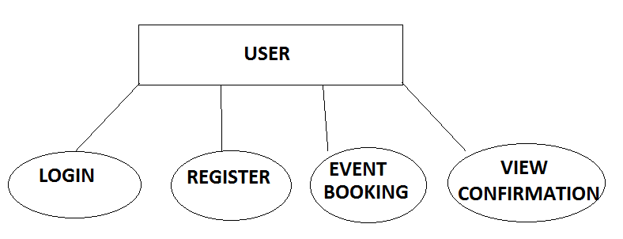
User Module

Slide 12
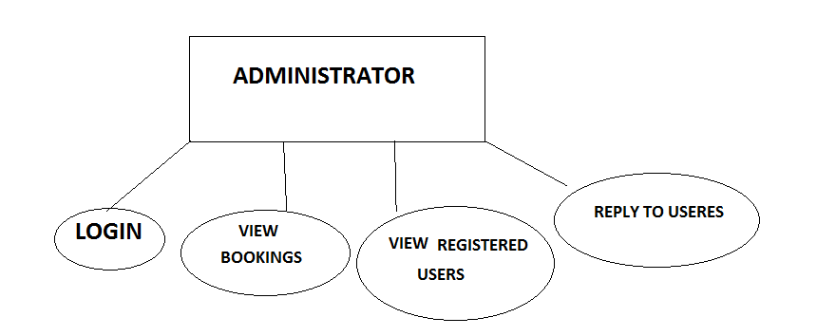
Administrator Module

Slide 13
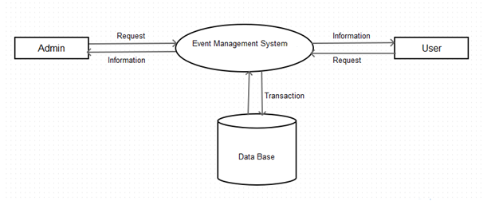
ARCHITECTURE

Slide 14
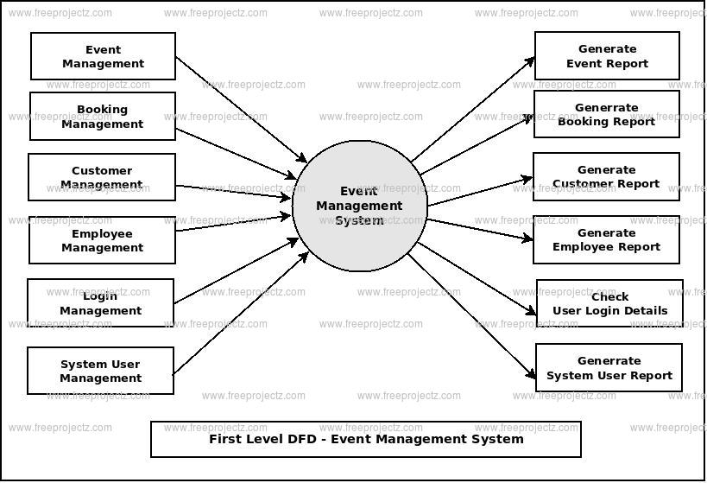
First level dfd

Slide 15
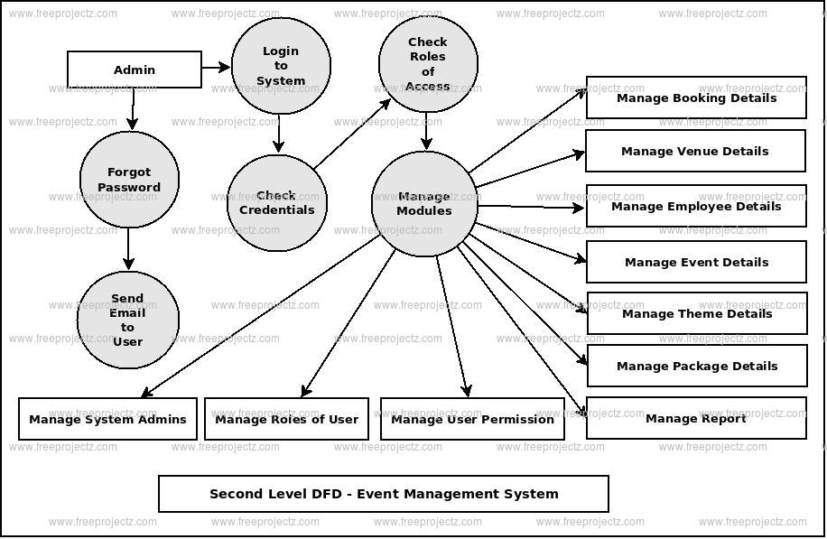
Second level dfd

Slide 16
TESTING AND IMPLEMENTATION
The term implementation has different meanings ranging from the conversation of a basic application to a complete replacement of a computer system. The procedures however, are virtually the same. Implementation includes all those activities that take place to convert from old system to new. The new system may be totally new replacing an existing manual or automated system or it may be major modification to an existing system. The method of implementation and time scale to be adopted is found out initially. Proper implementation is essential to provide a reliable system to meet organization requirement.

Slide 17
Classification of Methods Test Cases
In mission-critical software systems, where flawless performance is absolutely necessary, formal methods may be used to ensure the correct operation of a system. However, often for non-mission-critical software systems, formal methods prove to be very costly and an alternative method of software V&V must be sought out. In such cases, syntactic methods are often used.
A test case is a tool used in the process. Test cases may be prepared for software verification and software validation to determine if the product was built according to the requirements of the user. Other methods, such as reviews, may be used early in the life cycle to provide for software validation.

Slide 18
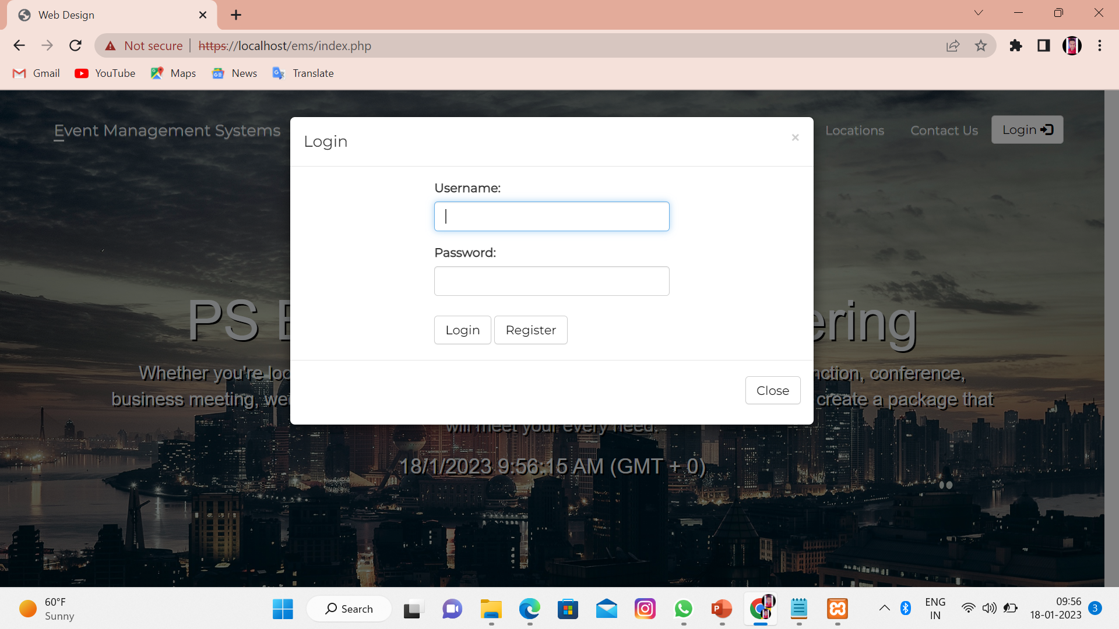
Login Screen

Slide 19
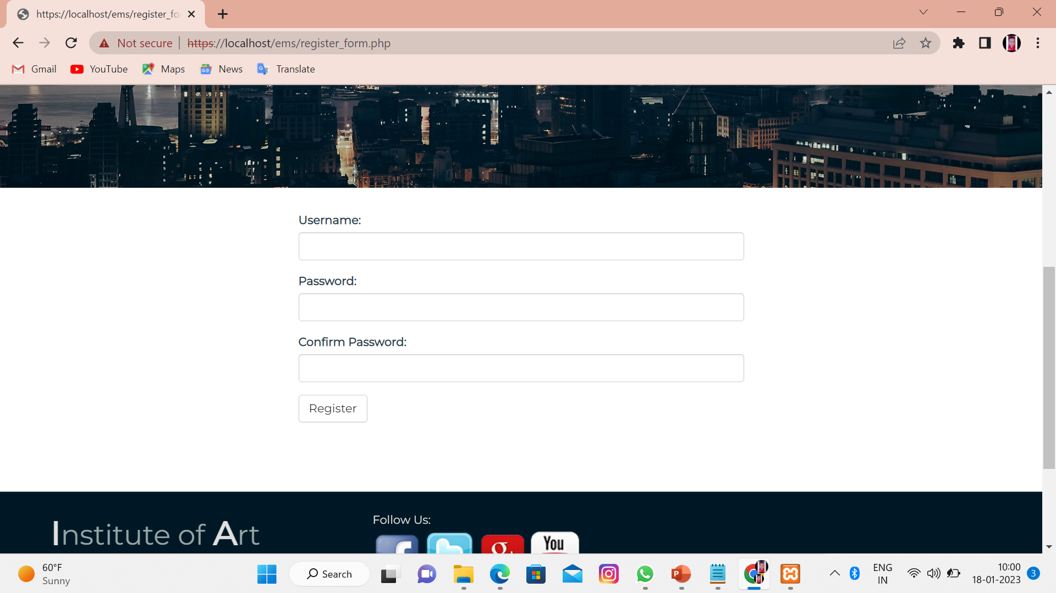
Register screen

Slide 20
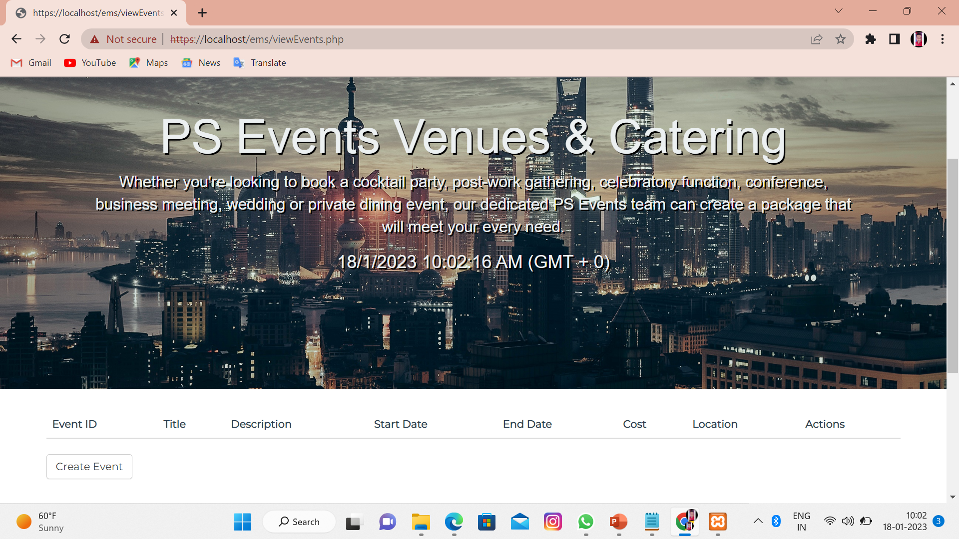
Create Event Page

Slide 21
conclusion
Event Management System is user friendly and cost effective system, it is customized with activities related to event management life-cycle. It provides a new edge to management industry. Solution always keep your objectives and goals on top priority while developing any plan of work.
As It is the growing system as ever one need new places to make their once in life event memoriable.

Slide 22
BibliographY
Bibliography:
Books of PHP, HTML, JS,
CSS
MYSQL
www.google.com

